Slide 1
MongoDB Tutorial
Group-3
Zekun Zhang
Ziqi Wang
Mo Shi

Slide 2
Steps
Create Database & Collections
Add MongoDB Array - insert()
Primary Key: Set _id Field

Slide 3
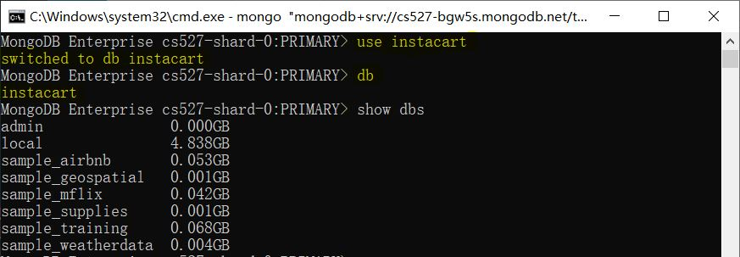
Create Database
Command form: use <db_name>
If the database does not exist, it will be created automatically
Use db command to check the current database
Use show dbs command to show all non-empty databases
The new database instacart is not shown since it’s still empty

Slide 4
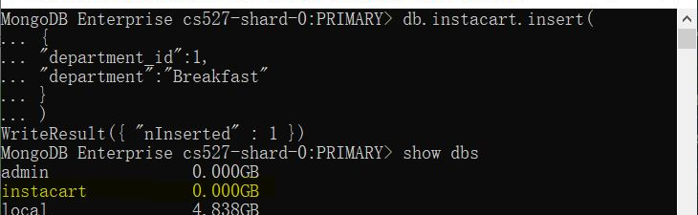
Create Collections
Collections: like the concept table in RDBS
Contains a collection of documents - like records(rows) in RDBS
Insert command: db.<collection_name>.insert()
Insert in the form of key-value pairs
Use insertion to automatically create the collection

Slide 5
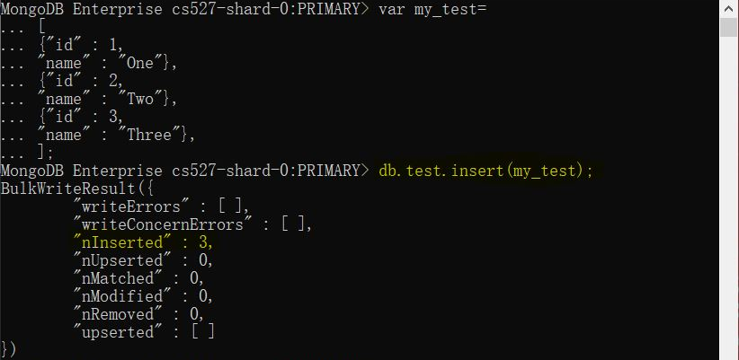
Insertion
Multiple insertion supported

Slide 6
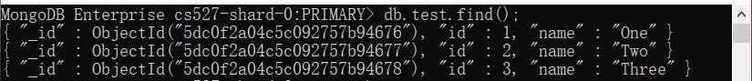
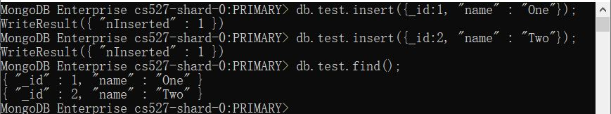
Set Primary Key
MongoDB will automatically set a primary key called ObjectID if the primary key is not manually set
Use _id as the key value to set primary key during insertion

